Slide 1
Chapter 4
How to retrieve data
from two or more tables

Slide 2
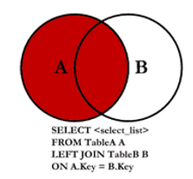
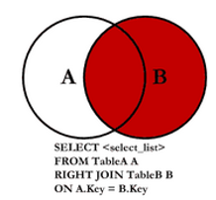
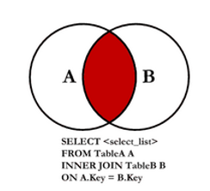
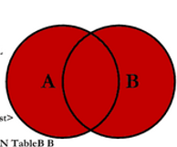

SQL Joins

Slide 3
Understanding Joins
Joins are queries that retrieve data from more than one table
Data get distributed across multiple tables due to Normalization
What is Normalization?
It’s a design methodology of organizing the tables of a relational database to minimize redundancy and dependency on the Data
It’s the process of breaking up data into discrete chunks and storing them in a table
Then create relationship between the tables using the PK-FK link
Also makes data management more efficient
However, it makes retrieving data a bit more complex or challenging

Slide 4
Understanding Joins
Redundant data is a problem…..
First | Last | Age | Policy | Zip
Harry | Smith | 23 | Auto | 48197
Angela | James | 34 | Auto | 48103
Sam | Jones | 43 | Auto | 48104
Sam | Jones | 43 | Boat | 48104
Sam | Jones | 43 | MC | 48104
We are storing all these extra data just so we can store the new added policy;
Auto, Boat, and MC for motorcycle

Slide 5
Understanding Joins
Normalization is the process of organizing the data in separate tables
Cust_ID | First | Last | Age | Zip
1 | Harry | Smith | 23 | 48197
2 | Angela | James | 34 | 48103
3 | Sam | Doe | 43 | 48104
Cust_ID | Policy
1 | Auto
2 | Auto
3 | Auto
3 | Boat
3 | MC

Slide 6
Database normalization
Normalization is useful because it minimizes duplicate data in any single table
Allows for data in the database to grow independently of each other (ie. Types of car engines can grow independent of each type of car).
As a trade-off, queries get slightly more complex since they have to be able to find data from different parts of the database, and performance issues can arise when working with many large tables.
In order to answer questions about an entity that has data spanning multiple tables in a normalized database, we need to learn how to write a query that can combine all that data and pull out exactly the information we need.

Slide 7
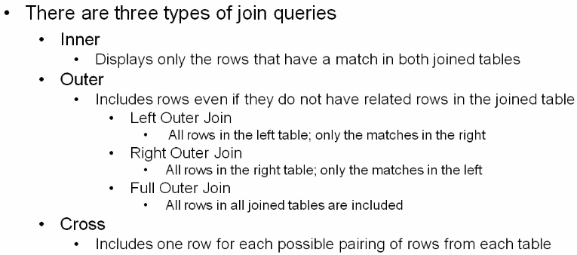
Understanding Joins

Slide 8
Joins
In most cases, you will join 2 tables based on the relationship between the PK in one table and the FK in the other table
If the 2 columns in a join condition have the same name, you have to qualify them with the table name so that SQL can distinguish between them.
To code a qualified column name; type the table name, following by a period, followed by the column name.

Slide 9

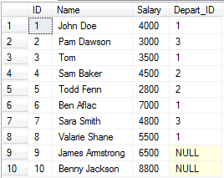
Joins in SQL Server
Joins in SQL server are used to retrieve data from 2 or more related tables.
- In general; tables are related to each other using foreign key constraints.
In SQL Server, there are different types of joins:
Inner Join
Outer Join: divided into
Left join OR Left Outer Join
Right Join OR Right Outer Join
Full Join OR Full Outer Join
Cross Join

Slide 10


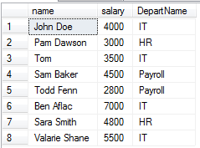
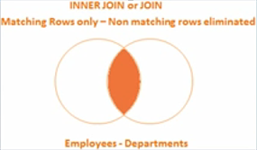
Inner Join
Inner Join returns only the matching rows between both tables. None matching rows are eliminated.
OR
Inner Join
Result Set➔
Notes:
Creating INNER Joins:
- Inner Joins return requested columns from 2 or more tables when data in both tables equal some specific condition
- Usually an equality condition between the PK and the FK

Slide 11
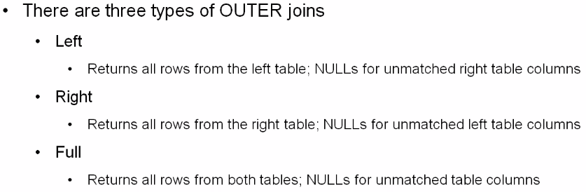
Outer Joins

Slide 12


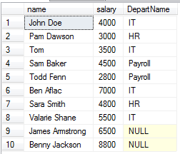

Left Outer Join
Left Outer Join returns all rows from the left table + the matching rows from the right table
OR
Left Join
Result Set➔

Slide 13


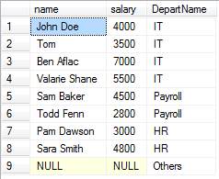

Right Outer Join
Right Outer Join returns all rows from the right table + the matching rows from the left table
OR
Right Join
Result Set➔

Slide 14


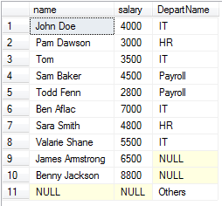

Full Outer Join
Full Join returns all rows from both left and right table including the none matching rows
OR
Full Join
Result Set➔

Slide 15

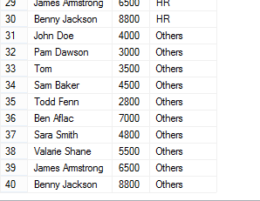
Cross Join
Cross Join returns the Cartesian product of 2 tables that are involved in the join. Pretty much multiplying the # of rows from 1 table by the # of rows of the other table.
Cross join doesn’t have ON clause
Cross join
Result Set➔

Slide 16
Joining using 3 tables
Select name, Product_name , Amount, Order_date
From customer AS C
inner join Orders AS O
on C.ID = O.Cust_ID
inner join products AS P
on o.product_ID = p.product_ID
Where o.amount > 400

Slide 17
Union, Union All, and Join
Why Union and Union All
What is the difference between Union and Union All
Difference between Union and Join

Slide 18


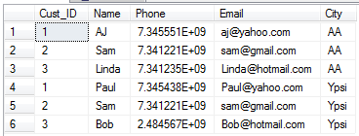
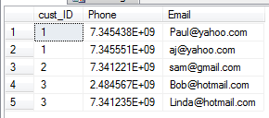
Union and Union All Operators
They are used to combine the result set of 2 or more Select queries
select * from BBY_AA_Customers
Union All
select * from BBY_Ypsi_Customers
select cust_ID, Phone, Email from BBY_AA_Customers
Union
select cust_ID, Phone, Email from BBY_Ypsi_Customers
Note: For Union and Union All to work, the number of columns, data type and the order in the select clause must be same.

Slide 19
Union, Union All, and Join
So what’s the difference between Union and Union All?
Union removes duplicate rows
Union All doesn’t
Union perform distinct sort to remove duplicates which effect performance
Union All doesn’t so it’s faster
Order by clause should be used only on the last Select statement of the Union query

Slide 20
Unions and Unions All… Summary
Rules:
The number of columns must be the same in both Select statement
The data types must be compatible
The column names in the result set are taken from the first select statement
Try to use UNION ALL statement instead of UNION, whenever possible. The UNION ALL statement is much faster than UNION, because UNION ALL statement does not look for duplicate rows, and UNION statement does look for duplicate rows, whether or not they exist.

Slide 21
Union, Union All, and Join… Continue
Union VS Join
Union combines the rows of 2 or more Select query into a single result set
Where as
Join combines columns from 2 or more tables

